Slide 1
Data Visualization and Dashboards with Tableau
Paul Abah

Slide 2
Objective
The objective of this project was to create dashboards using various visualizations and insights from data on Real Estate Prices and Incomes across various districts within Canada.
With the insights generated, stakeholders and end users can better understand the changes in real estate prices over the years across various districts in Canada and also see how that compares with changes in earnings over the years as well.

Slide 3
Project Structure Flow
Import dataset to Tableau
Exploratory Analysis
Review Project objectives
Data manipulations and created calculated Fields
Create meaningful visualizations

Slide 4
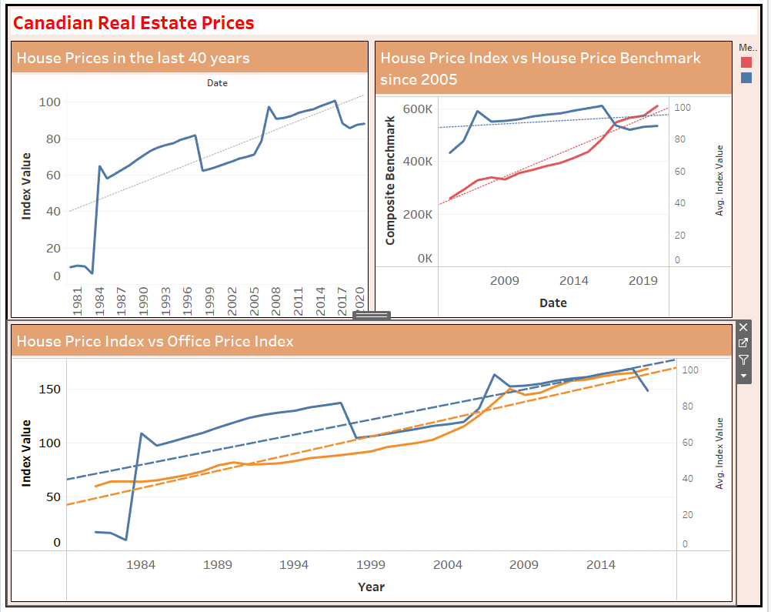
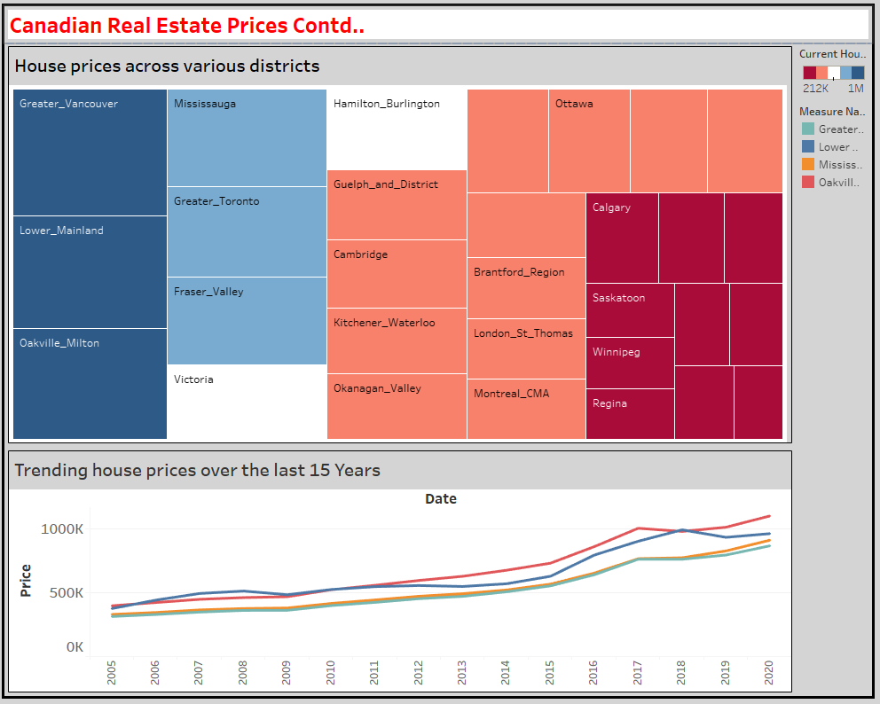
Results and Findings

Slide 5
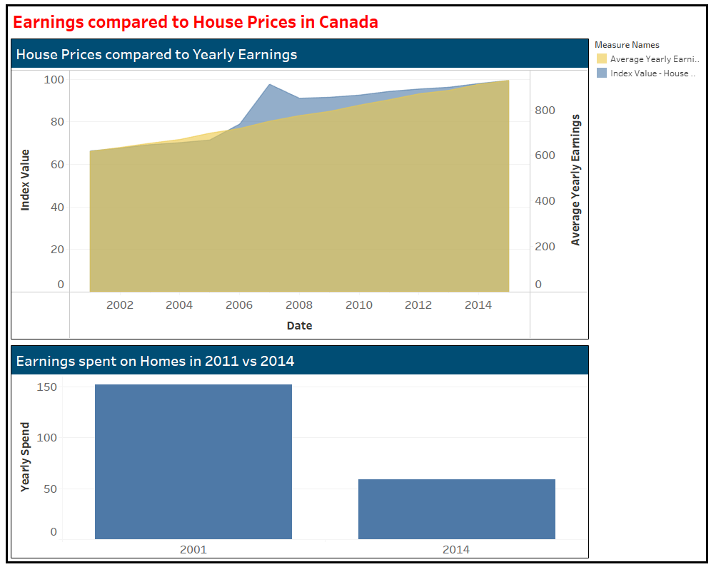
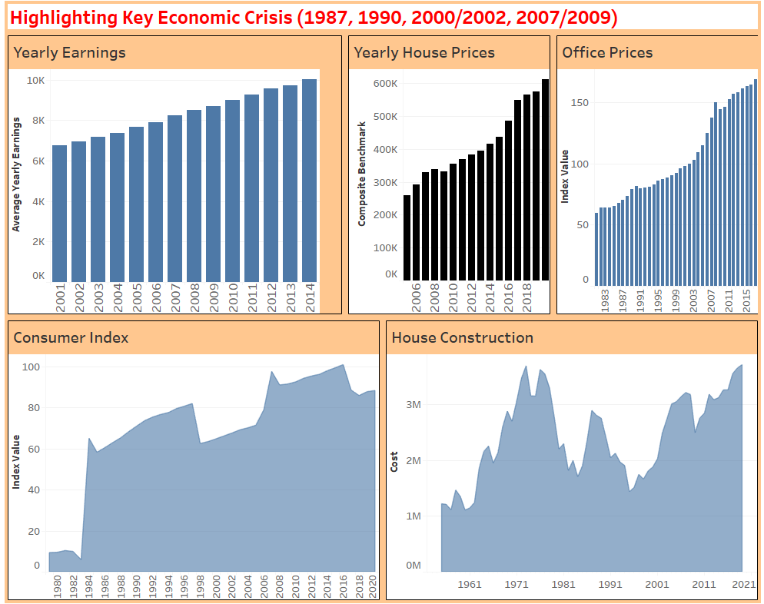
Results and Findings

Slide 6
Challenges and Learning Points
First, I struggled with importing the JSON file as tableau. The resulting table was not accurate. I resolved this by importing the file into python and using pandas to convert it into a data frame, then exported it to CSV.
I also struggled with manipulating data on Tableau but I believe this will improve as I practice more with the application.
Lastly, I am not sure if it is due to the version of the application I have but I had some limitations with selecting certain visualizations that I needed.

Slide 7
Thank you.

